Slide 1
Italy

Slide 2
content
1. Italy
2. Location
3. Natural Character
4. Venice
5. Rome
6. The Leaning Tower

Slide 3
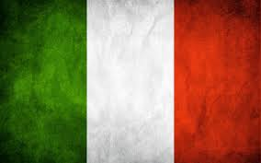
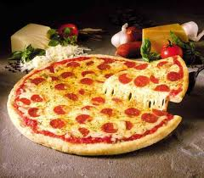
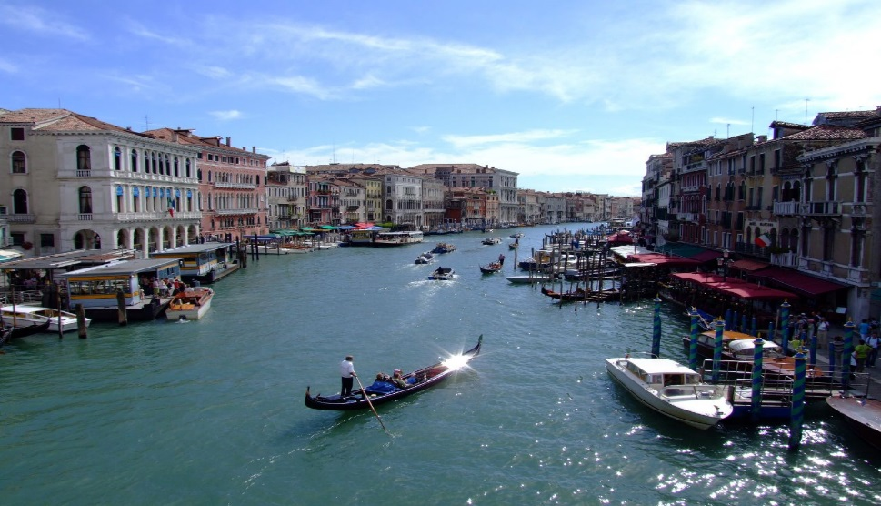
Italy
Italy was the center of the Roman Empire which left archaeological, cultural and literary heritage. European thought and art has developed through historical figures, like those of Machiavelli, Dante, Leonardo da Vinci and Galileo. In Italy live 60,770,000 people.

Slide 4
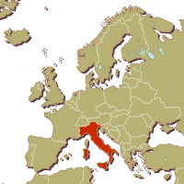
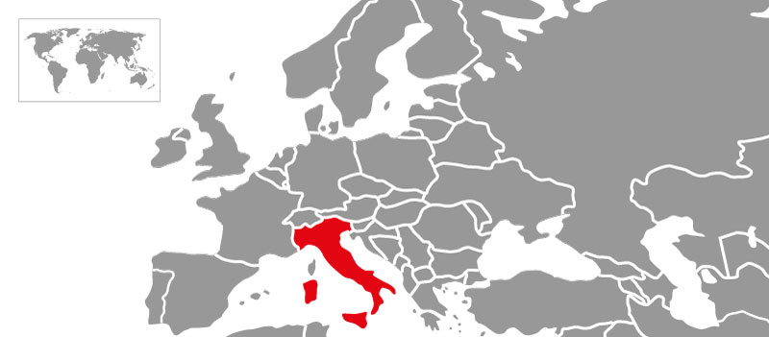
location
Italy is located in the territory of southern Europe on the Apennine peninsula. Its territory includes the islands of Sicily, Sardinia, Elba, Capri, Ischia and Tremiti.

Slide 5
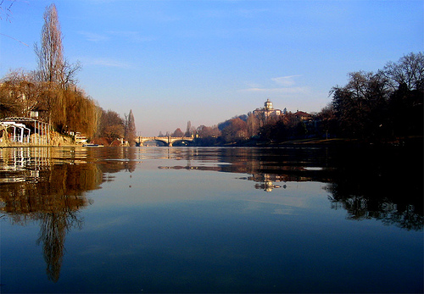
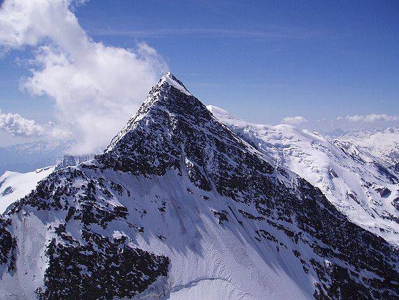
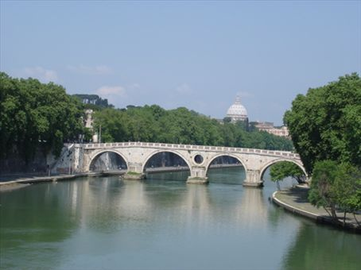
Natural Character
Surface- Italy is mainly mountainous country. In the north are the mountains Alps and on border with France lies the highest peak of Europe Mont Blanc wich is 4810 meters high.
Climate- the climate is mostly subtropical only in the north is the mild climate
Waters- the most important river is the 652 km long river Po. Famous are the Adige river and the Tiber river too.

Slide 6
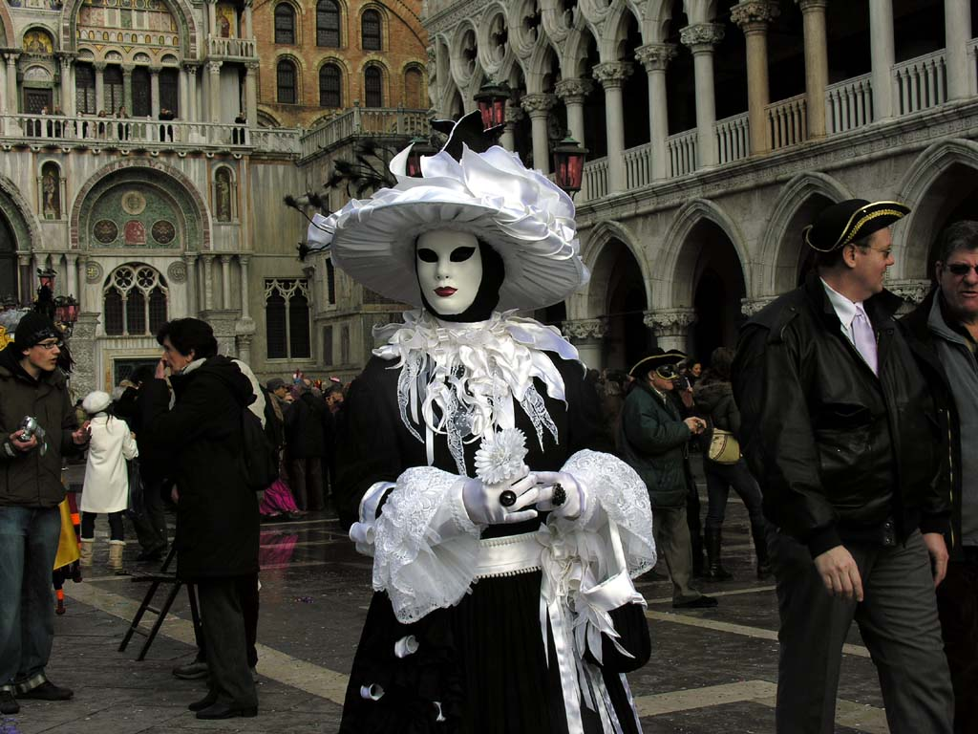
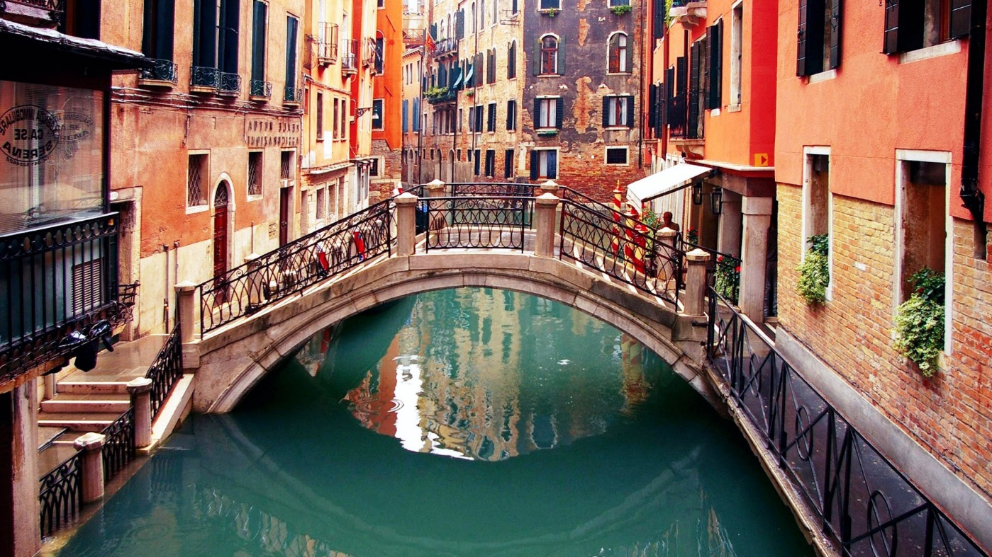
Venice
The main transport route is the Grand Canal, 4 km long and about 70 m wide cannel. Main street and about a hundred cannels there is great traffic.
In the Venice Carnival takes place every year.

Slide 7
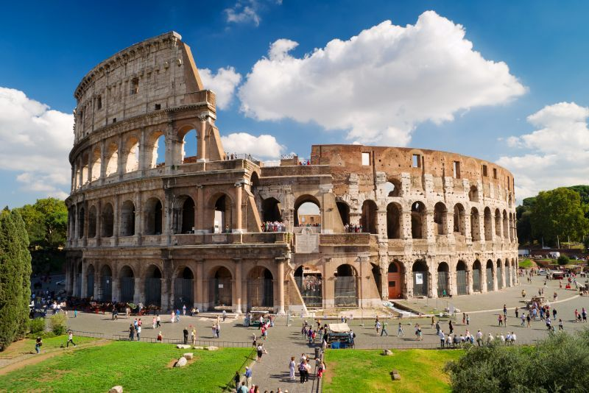
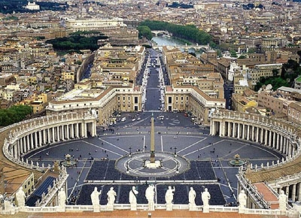
Rome
Rome is the capital and largest city in Italy.
Its history is long - 2800 years.
Vatican City in Rome is the seat of the Pope.
In Rome is the Colloseum.

Slide 8
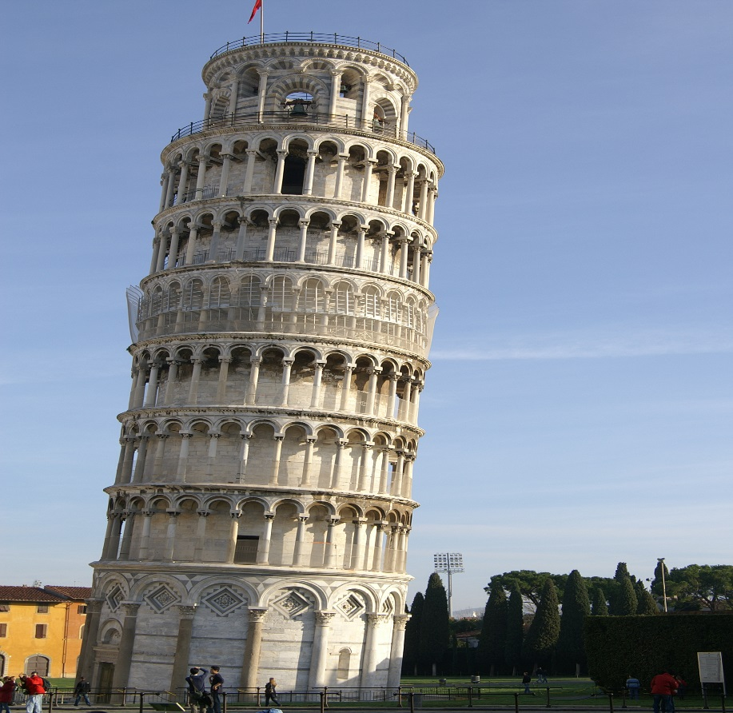
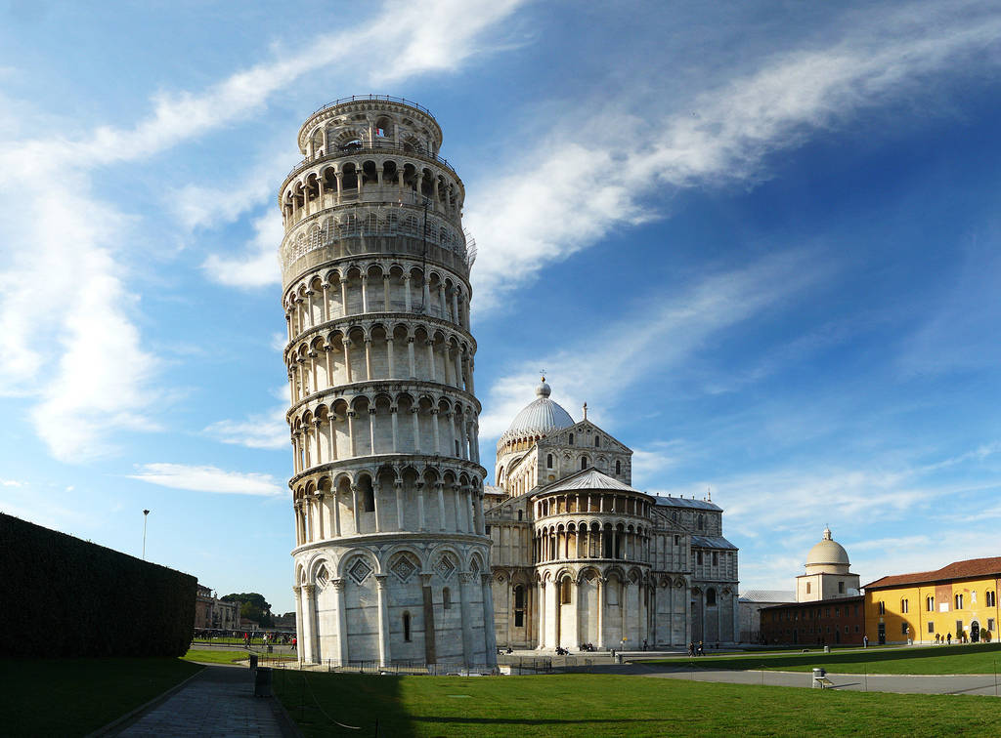
The Leaning Tower
The Leaning Tower is famous for the fact that physicist Galileo Galilei studies of gravity and free fall there.
Leaning tower leaneds because underneath is the soft ground.

Slide 9
Thank you for attention
Origin: Text-wikipedia, Pictures-Google
By: Matej Šulek

